Slide 1
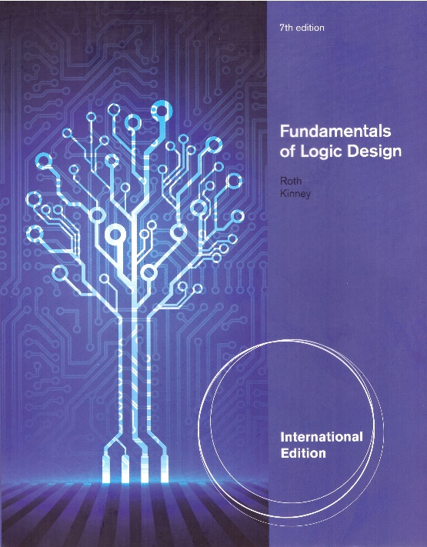
Logic Design Course Introduction
What is Logic Design?
Essential for hardware and software courses
Digital Systems Design, Computer Architecture, Operating Systems,,,
Refer the attached course maps for Semi & CS Departments
Textbook
Fundamentals of Logic Design, 7th edition
Charles H. Roth, Jr. & Larry L. Kinney
The most famous and popular textbook over the world
Notes:
Hello, my students.
Welcome to Logic Design class.
This class is very essential for hardware and software areas such as Computer Architecture, Digital System Design, and Operating Systems.
The textbook is “Fundamentals of Logic Design, 7th edition”, which is written by Roth and Kinney.
It is one of the most popular textbooks over the world.
During the semester, I would like to cover from Unit 1 to Unit 14.
Unfortunately Unit 10 will be skipped because of lack of Computer Aided Design (CAD) tools.
Unit 15 is optional, depends on the course progress.
Right now we are experiencing the corona virus crisis.
So the exam schedule is not clear at this moment.
Details to be decided and be announced.

Slide 2

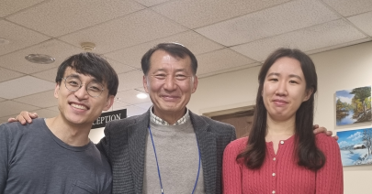

Logic Design Course Introduction
Professor: Chilgee Steve Lee (cslee@skku.edu)
Not Computer Science
Phone: 031-290-7123
Office: Semi building 400308
SF Golden Gate Bridge
Jan. 2023
Former students:
Soft gentleman & Hard lady
Jan. 2023
Notes:
Okey-doke! It’s me! Professor Chilgee Steve Lee.
It is my pleasure being with you young guys.
I know you’ve got a plan.
Feel free to contact me with any issues related to the logic design.
I’m old enough to consult you.
I mean I have various experience, not just only Engineering Research and Development.
I really hope you enjoy this Logic Design class.
Are you ready to start Unit 1?

Slide 3
Logic Design Course Introduction
System
Function
input
output
Function
Hardware + Software
My choice?
Fast processing
Tough modification
Slow processing
Easy modification
Notes:
Okey-doke! It’s me! Professor Chilgee Steve Lee.
It is my pleasure being with you young guys.
I know you’ve got a plan.
Feel free to contact me with any issues related to the logic design.
I’m old enough to consult you.
I mean I have various experience, not just only Engineering Research and Development.
I really hope you enjoy this Logic Design class.
Are you ready to start Unit 1?

Slide 4




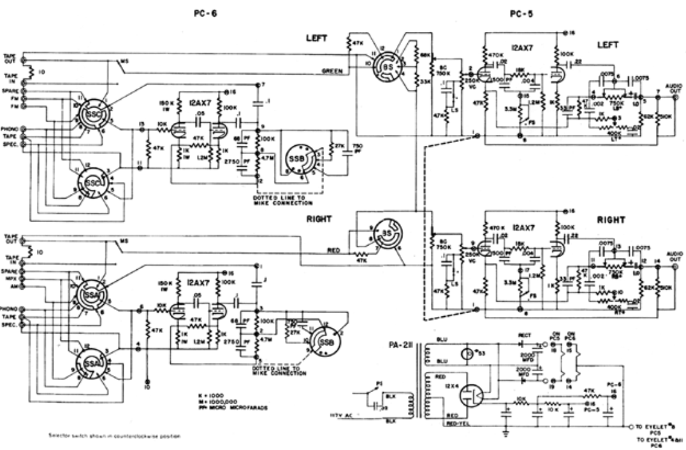
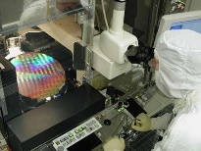
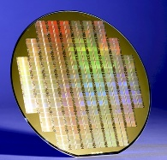


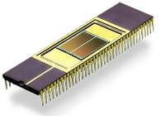
Logic Design Course Introduction
System Hardware
Manufacturing
Hardware + Software
Design
FAB
EDS
ASSY
TEST
Sales
Fabless
Foundary/Packaging
Notes:
Okey-doke! It’s me! Professor Chilgee Steve Lee.
It is my pleasure being with you young guys.
I know you’ve got a plan.
Feel free to contact me with any issues related to the logic design.
I’m old enough to consult you.
I mean I have various experience, not just only Engineering Research and Development.
I really hope you enjoy this Logic Design class.
Are you ready to start Unit 1?

Slide 5
Logic Design Course Introduction
System Software
Notes:
Okey-doke! It’s me! Professor Chilgee Steve Lee.
It is my pleasure being with you young guys.
I know you’ve got a plan.
Feel free to contact me with any issues related to the logic design.
I’m old enough to consult you.
I mean I have various experience, not just only Engineering Research and Development.
I really hope you enjoy this Logic Design class.
Are you ready to start Unit 1?

Slide 6
Logic Design Course Introduction
Hardware & Software Integration
HW
Hardware Development
System
H
/
W
Requirement
S
/
W
System
Analysis
Integration
Testing
Software
Software
Requirement
Development
Analysis
Defect Tracking
SW
&
Maintenance
Notes:
Okey-doke! It’s me! Professor Chilgee Steve Lee.
It is my pleasure being with you young guys.
I know you’ve got a plan.
Feel free to contact me with any issues related to the logic design.
I’m old enough to consult you.
I mean I have various experience, not just only Engineering Research and Development.
I really hope you enjoy this Logic Design class.
Are you ready to start Unit 1?

Slide 7
Logic Design Course Introduction
Course scope
Unit 1 Introduction & Number Systems and Conversion
Unit 9 MUX, Decoders, & PLD
Unit 10 will be skipped
Unit 11 Latches & Flip-Flops
Unit 14 Design of State Graphs & Tables
Unit 15 Reduction of State Tables (optional)
Course Grading
a few assignments (20%)
a midterm (40 %) & a final (40 %)
Notes:
Hello, Everybody.
Welcome to Logic Design class.
This class is very essential for hardware and software areas such as Computer Architecture, Digital System Design, and Operating Systems.
The textbook is “Fundamentals of Logic Design, 7th edition”, which is written by Roth and Kinney.
It is one of the most popular textbooks over the world.
During the semester, I would like to cover from Unit 1 to Unit 14.
Unfortunately Unit 10 will be skipped because of lack of Computer Aided Design (CAD) tools.
Unit 15 is optional, depends on the course progress.
Right now we are experiencing the corona virus crisis.
So the exam schedule is not clear at this moment.
Details to be decided.

Slide 8
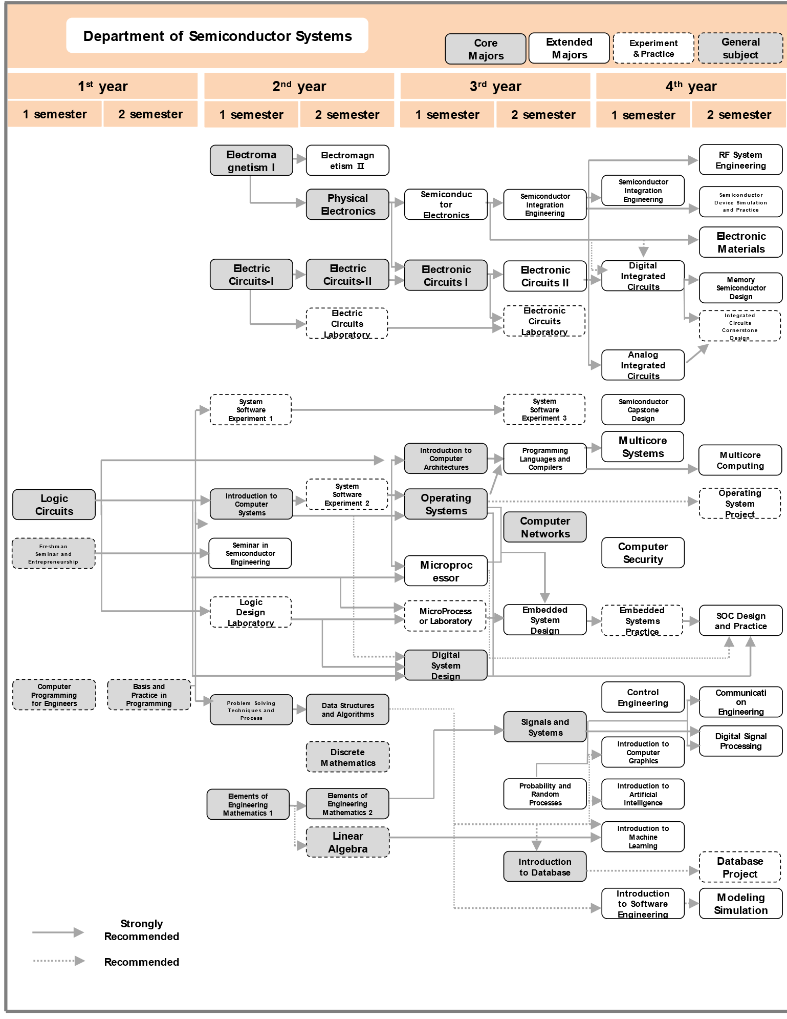
Course Map for Semiconductor
& Systems Engineering Dept.

Slide 9
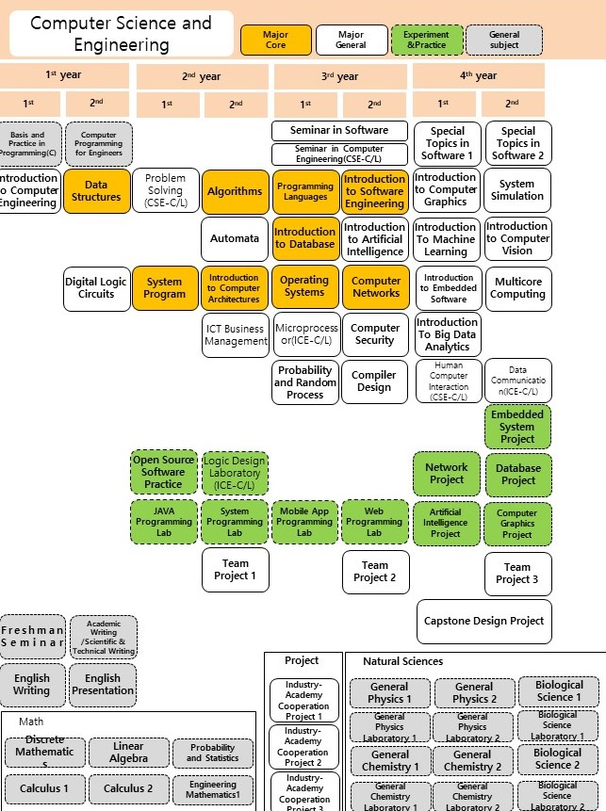
Course Map for CS

